Slide 1
Handwritten Digit Recognizer
Deep Learning Model using TensorFlow & CNN
ALEKHYA CHATTERJEE

Slide 2
Problem Statement
Manual recognition of handwritten digits is time-consuming & error-prone.
Needed in banks, postal services, and form processing.
A deep learning model can automate digit classification with higher speed & accuracy.

Slide 3
Objective
Build a Convolutional Neural Network (CNN) using TensorFlow.
Train on the MNIST dataset (60,000 images).
Evaluate accuracy on test dataset (10,000 images).
Predict unseen handwritten digits with ~98% accuracy.

Slide 4
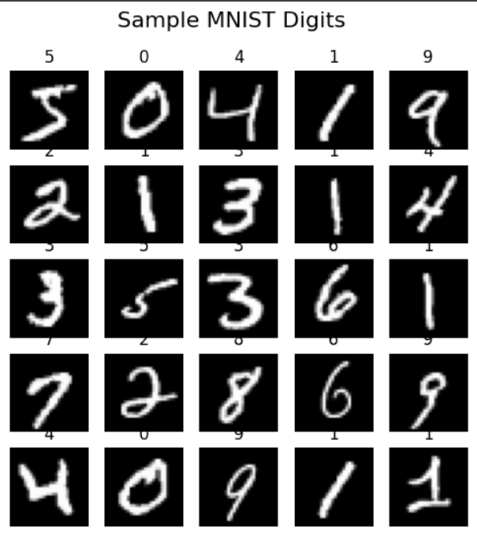
Dataset (MNIST)
Source: TensorFlow/Keras Datasets
Image size: 28×28 pixels
Grayscale (values 0–255) → Normalized (0–1)
Classes: 10 digits (0–9)
Training set: 60,000 samples
Test set: 10,000 samples

Slide 5
Workflow
Data Loading – Import MNIST dataset
Preprocessing – Normalize pixels, reshape images
Model Building – CNN (Conv2D, MaxPooling, Dense layers)
Compilation – Adam optimizer, categorical crossentropy loss
Training – Fit model on training set
Evaluation – Test accuracy & loss metrics
Prediction – Predict unseen digit images
Visualization – Plot accuracy & prediction results

Slide 6
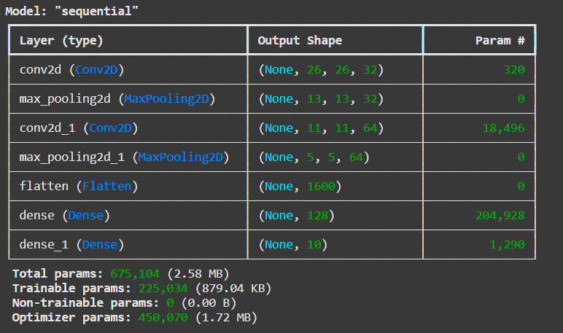
CNN Model Architecture
Input Layer: 28×28×1 grayscale image
Conv2D + ReLU Activation (32 filters, 3×3)
MaxPooling2D (2×2)
Conv2D + ReLU Activation (64 filters, 3×3)
MaxPooling2D (2×2)
Flatten Layer
Dense Layer (128 units, ReLU)
Output Layer (10 units, Softmax)

Slide 7
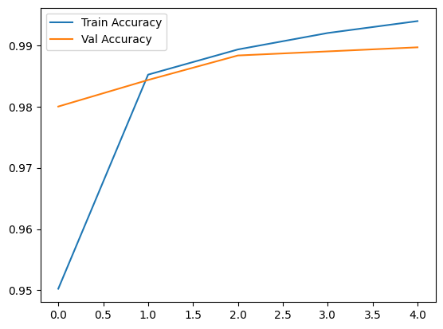
Model Training & Evaluation
Optimizer: Adam
Loss Function: Categorical Crossentropy
Epochs: 5 (can be increased)
Training Accuracy: ~99%
Test Accuracy: ~98%
Validation curves show minimal overfitting
Training vs Validation Accuracy

Slide 8
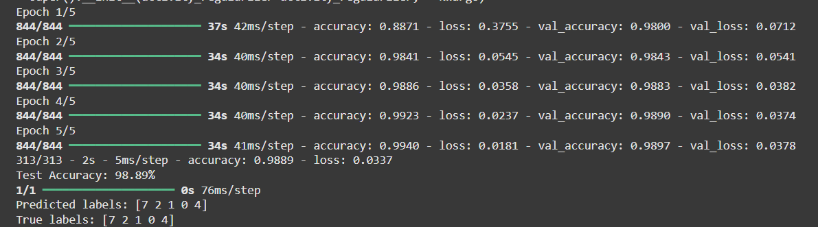
Results & Predictions
Model correctly predicts unseen digit images.
Example:
Input Image → 7
Predicted Output → 7
Performance: ~98% accuracy on test data

Slide 9
Applications
Bank check digit recognition
Postal code/ZIP code automation
Digital form processing
CAPTCHA recognition systems
Real-time handwriting recognition apps

Slide 10
Conclusion
Successfully built a CNN model to classify handwritten digits.
Achieved ~98% accuracy on MNIST dataset.
Demonstrates the power of deep learning in image classification.

